Slide 1
India’s Experiences with establishing a robust Health DPI environment High Level Workshop for South African Delegation, New Delhi
Kiran Gopal Vaska
Mission Director, Ayushman Bharat Digital Mission
And Joint Secretary, National Health Authority
Dec 2nd, 2024

Slide 2
India Stack – Unique digital infrastructure as public goods
1
2
3
4
5
6
7
8
9
Aadhaar
eKYC
eSign
Digi
Locker
UPI BHIM
FastTag ETC
GSTN
CoWIN
ABDM
2009
2012
2015
2015
2016
2017
2017
2020
2021
A set of serendipitously developed open APIs built for a Digital India

Slide 3
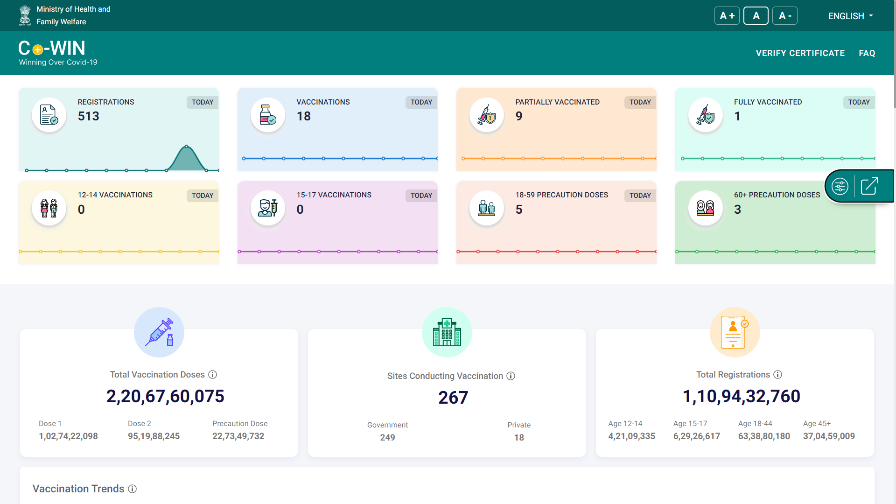
Precursors of success in Digital Health - Scalable and Frugal
Vaccines Administered
Live Dashboard
(dashboard.cowin.gov.in)
1.1Bn+
Registered Citizens
2.20Bn+
Total Vaccines Administered
25M
~65K
Vaccinations Recorded in One Day
Maximum Rate of API Hits per Second
Global Milestone: Highest Number of Vaccinations recorded in a Day across the world in one Nation

Slide 4
Enabling a Digital Health Ecosystem and simplifying Digital Health Transactions
Ayushman Bharat Digital Mission was launched in 2021
Guiding principles of Ayushman Bharat Digital Mission
Single Source of Truth
Privacy & Security by design
Unique identities and registries to establish identity in the ecosystem
Consent and encryption to ensure security of user data.
Federated Architecture
User inclusivity
Interconnected yet independent systems.
Equitable access for all users.
Technology
Policy
Open APIs & Interoperability
Voluntary Participation
Interoperable standards for seamless transfer of data
Optional involvement, no coercion.
IndEA Framework
Wellness Centric
India Enterprise architecture approach to build digital governance
Moving away from curative to preventive healthcare

Slide 5
Single Source of Truth to Establish Trust in the Ecosystem
ABHA
(Citizens Registry)
HPR
Healthcare Professional Registry
HFR
Health Facility Registry
14 digit random number designed to be a unique patient identifier for citizens
Centrally maintained comprehensive registry of all health delivery staff (medical and non-medical staff)
Centrally maintained comprehensive registry of all information of health facilities in the country
692 Mn+
ABHA Numbers
Created
527k+
Professionals
Registered
351k+
Facilities
Registered
as of Dec 1st, 2024

Slide 6
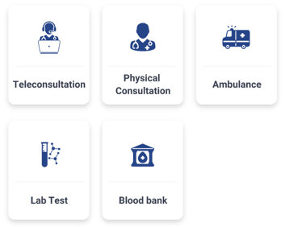
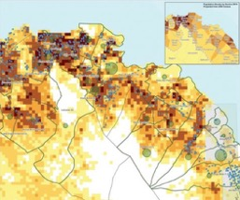
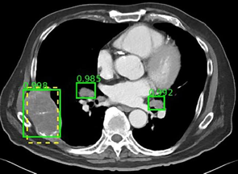
ABDM Gateways : Building DPI for the Health Ecosystem
Interoperable
Health Data
via
Health Information Exchanges (HIE-CM)
Interoperable
Health Claims via
National Health Claim Exchanges
(NHCX)
Enable inter-operable Health Services
Via
Unified Health Interface (UHI)
Personal Health Records
Disease Surveillance & data for public Health management
Anonymized large datasets for machine learning
Standardize the interchange of information between payers and providers
Allow consumers to choose any UHI app to reach any participating health care provider for these services

Slide 7
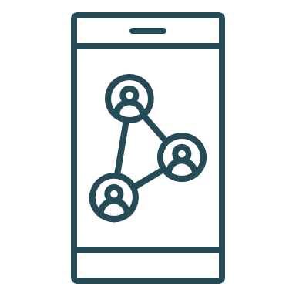
ABDM Enabling Interoperability with Gateways and Registries
Government Hospitals
… others
Private Hospitals
Health Applications & Lockers
ABDM
ABDM
ABDM
Government Health Programs
ABDM
General Practitioner
ASHA/ ANM/ FLWs
Laboratories
ABDM enables interoperability so that multiple applications can talk to each other

Slide 8
ABDM: Intended benefits to stakeholders
Patient empowerment
Better control over health
Time and cost saving
Personalized Care Planning
Citizens
Better Clinical Decision making
Easy compliance to laws
Efficient Record Management
Precision Medicine
Healthcare Providers
Public Health Monitoring at all levels
Promoting Health Equity
Epidemiological Research and Policy Development
Efficient resource allocation & utilization
Policy Makers

Slide 9
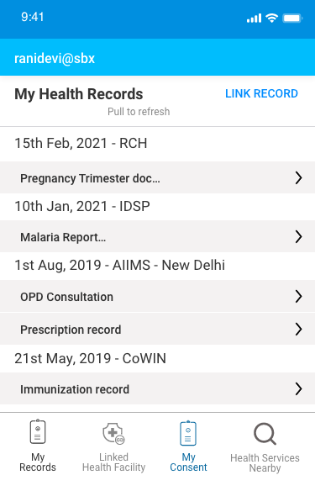
Use Cases - Citizen Centric View of Public Health
Citizen’s longitudinal health record
Ms. Ranidevi
Female, 28 years old
ABHA
Govt Hospitals
CoWIN
Private Hospital Data
RCH
IDSP
Pregnancy
Trimester:
Hb: 9.8
Weight 52kgs
Tab IFA
Injection TT
Malaria confirmed
Tab - chloroquine
URTI
Tab – Azithromycin
1 TDS 5 days
Covid vaccine
dose 1
URTI Tab cefixime
1 BD – 5 days
CoWIN
Reproductive & Child Health (RCH)
Tuberculosis Elimination Program
Integrated Disease Surveillance Program (IDSP)
Government Hospitals
Private Hospitals
Date:
15/02/21
Date:
10/01/21
Date:
01/08/19
Date:
21/05/19
Date:
21/02/19
Longitudinal health record available to all health workers of programs in their jurisdiction
Frontline Workers
Nurses
Doctors

Slide 10
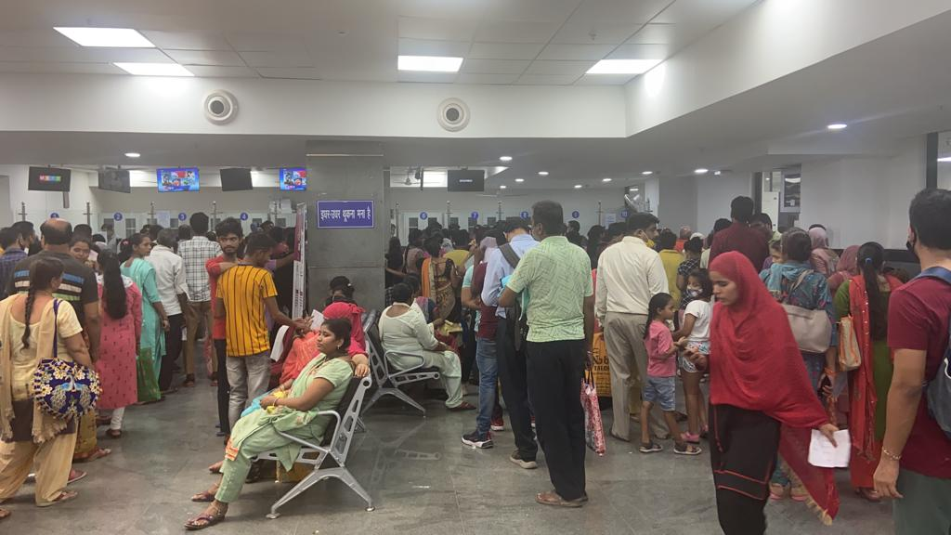
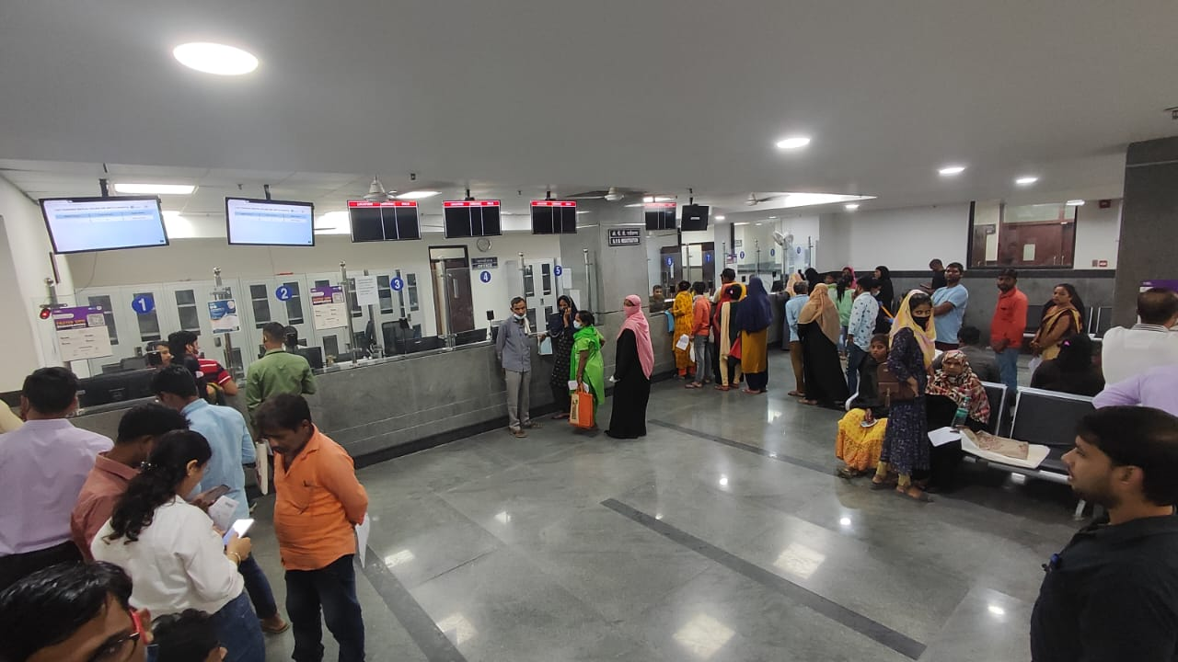
Scan and Share : Solving the problem of queues at Govt Hospitals
Long queues at OPD for registrations
Ensuring correct data entry in limited time
Uniquely identifying patient for quality care
QR code a widely acceptable concept
Ensure timely entry of accurate data
Bring ease in registration for patient
After QR Based OPD registration Rollout
Waiting time of 50 minutes reduced to 4-5 minutes

Slide 11
National Health Claims Exchange - Standardising Health Claims
What is the NHCX?
A clearing house for rules-based adjudication and processing of standardized eClaim, in collaboration with National Insurance Regulator
Submit using open APis
Claim Processing
Route to Insurer
/ TPA
Hospitals
Health Claims Platform
Insurance companies
Fraud
prevention
NHCX allows insurers to use common digital infrastructure to drive operational efficiencies and use sophisticated claim engines

Slide 12
AB-PMJAY: Cashless Health Assurance Scheme running on IT
Impact in Numbers
as of Dec 1, 2024
Poorest 40%
Population covered
INR 500,000
Health Cover
80 mn
Hospitalization
360 mn
Ayushman Cards created
Cashless
And
Paperless
Robust IT
Platform
600 mn+ Beneficiaries
USD 12 bn+
Worth of Treatment
~30,000
Hospitals
Empanelled
World’s largest public funded health assurance program

Slide 13
From CoWIN to UWIN
India is now taking the digital route for its Universal Immunization Programme (UIP)
Core Functionalities
UWIN
Tech Backbone of India’s Vaccination Program
UIP - one of the largest public health programs in the world
Free vaccination to all pregnant women & children
Against 12 vaccine preventable diseases
Blended Registration
Digital & Offline Walk-ins
Mobile #
Track Vaccination Schedule
Guidance on interval between two doses based on vaccine brand
Convenience in Slot Booking
Choose vaccination slot based on convenient time and location
Instant Digital Certificate
Verifiable QR code
ABDM Linked

Slide 14
National Tele Medicine Service – e Sanjeevani
Driving 4 Sustainable Development Goals
Using Technology for service delivery
Cloud-based Solutions
Scalable Architecture
Standard Terminologies
Multiple VC layout

Slide 15
National Tele Medicine Service – e Sanjeevani
Overall Statistics
as of Dec 1, 2024
318 mn+
Patients Served
400k +
Consultations per day
130
Specialities
227,000+
Providers Onboarded
12%
Senior Citizens
57%
Women
Huge Impact: Addressing the healthcare needs of the most vulnerable sections of the population
130,000+
Spokes Operationalized
16,600+
Hubs Established

Slide 16
National Tele Mental Health Programme – Tele MANAS
Coverage of Tele MANAS
as of Dec 1st, 2024
1.6 Mn+
Total Number of Calls
53
Tele MANAS Cells in India
23
Mentoring Institutes
5
Regional Coordinating Centres
Huge Impact: Handling about 3,500 calls per day Addressing the mental healthcare needs of the most vulnerable sections of the population
Multi-language support available in 20 Indian Languages

Slide 17
Unleashing the power of Digital Health : The road ahead
Build trust through transparency and security
Anonymised and aggregated data to inform policy & research
Sharing international best practices in digital health
Increasing interoperability of health data
Strengthening digital health regulation
Harmonising health data governance to allow cross-country collaboration

Slide 18
Thank You!

