Slide 1


DBT Mission
Cabinet Secretariat
Introduction to Direct Benefits Transfer (DBT)
DBT Mission extends a warm welcome to all delegates from South Africa

Slide 2
Direct Benefit Transfer (DBT)- Genesis
Launched about a decade ago as a good governance reform initiative aimed at improving public service delivery to ensure that the benefits are delivered efficiently and timely.
Tool for re-engineering Government processes.
DBT Mission
  Nodal Point for Implementation of DBT in India
  Initially created in Planning Commission (now NITI Aayog) in 2012
  Transferred to Department of Expenditure in July, 2013
  Transferred to Cabinet Secretariat in September, 2015

Slide 3
Meaning of DBT
D
Direct – Without any middlemen
B
Benefits – Cash and In-kind
T
Transfers – Electronic; Authentication-based

Slide 4
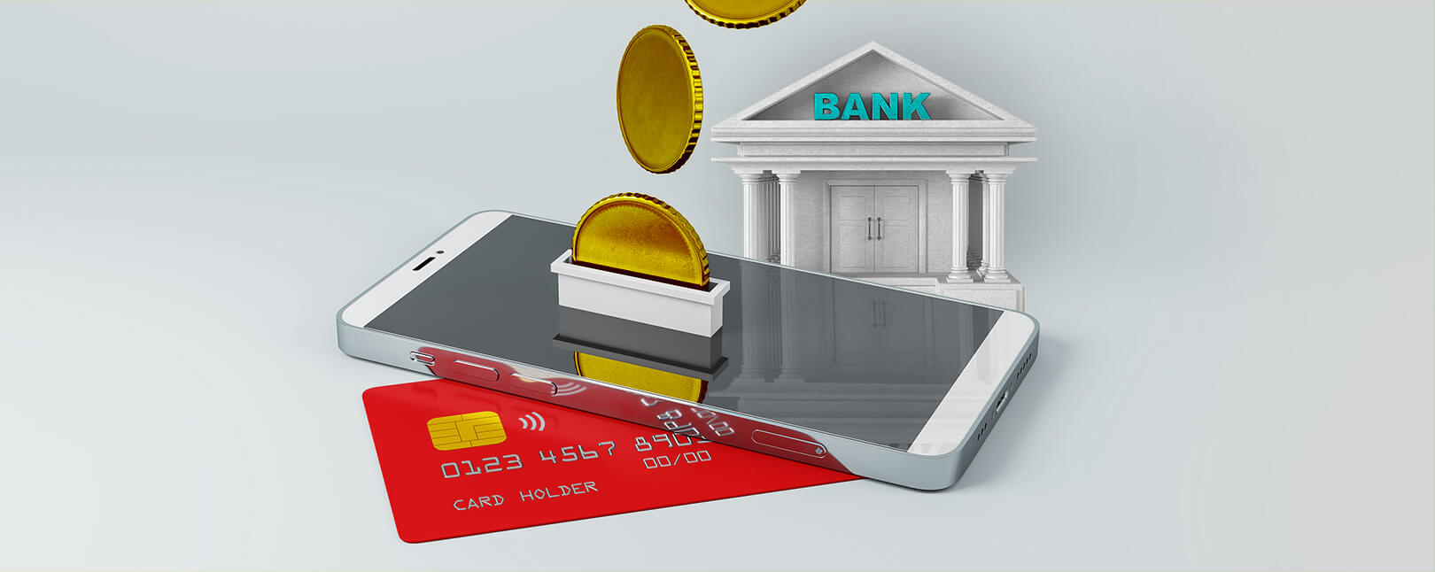

Types of DBT - Cash
Examples
z
Cash subsidy entails the government transferring money directly to bank account of the targeted, identified beneficiaries electronically and also ensures adequate cash out points
Subsidy & Welfare Schemes
(Eg. MGNREGS, PAHAL, PM-Kisan)
Social Security Pensions
Scholarships & Fellowships
Cash
Out

Slide 5
Types of DBT – In Kind
In-kind transfers are benefits the government provides to targeted, identified and Aadhaar authenticated beneficiaries in the form of goods and services
Examples
Delivery of In-kind subsidies
(Eg. food, fertilizer etc.)
Training & Skill Development

Slide 6

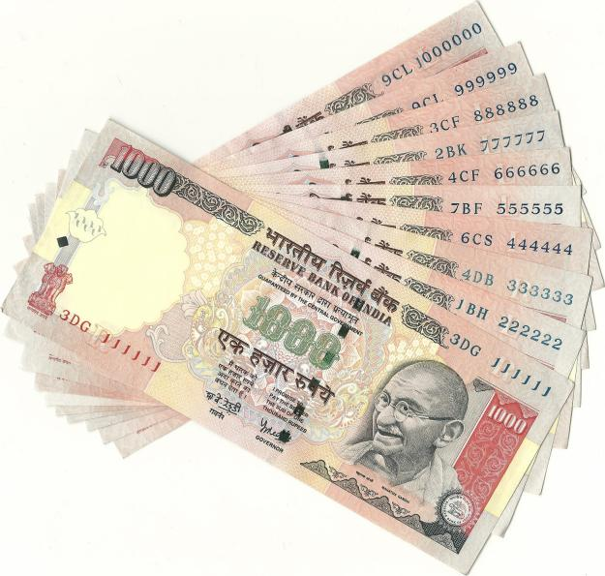
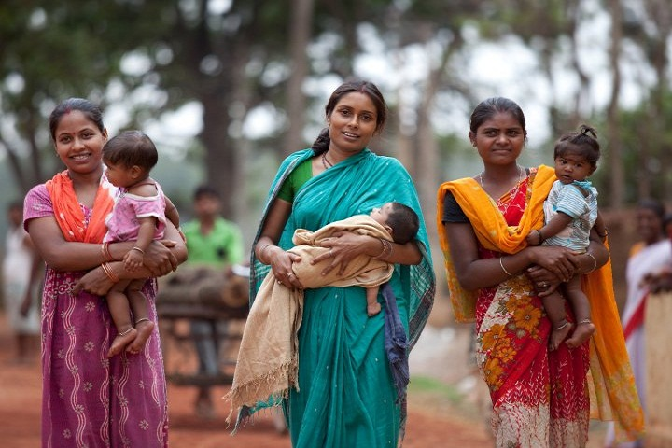


DBT Journey
24 Schemes
121 Districts
All Central Schemes
All Districts
Launch of DBT Bharat Portal
34 Schemes
All Districts
DBT Scope Expansion
Cash, In-kind
320 Central Schemes and 2500+ State Schemes
Jan, 2013
Dec, 2014
Feb, 2015
Mar, 2016
Aug, 2016
Nov, 2024

Slide 7
DBT Progress – Infographics
Fund Transfer (Annual)
(in Rs bn)
Beneficiaries (Annual)
Non-unique (in bn)
Total cumulative DBT Transfers
₹ 40.26 trillion
Note: Information for FY 2024-25 is Provisional
Source: dbtbharat.gov.in

Slide 8
Achievements of Aadhaar-based DBT
Accurate identification & targeting of beneficiaries
Greater inclusion and ease of availing services through online application
Augments ease of living for bonafide beneficiaries
Transparency in fund transfers to beneficiaries
Curbed leakages in the benefit delivery processes through elimination of middlemen/agents
Greater accountability of the Government
Facilitated reforms in Government processes through re-engineering
Increased efficiency in scheme delivery
Ensures effectiveness of schemes through timely implementation

Slide 9
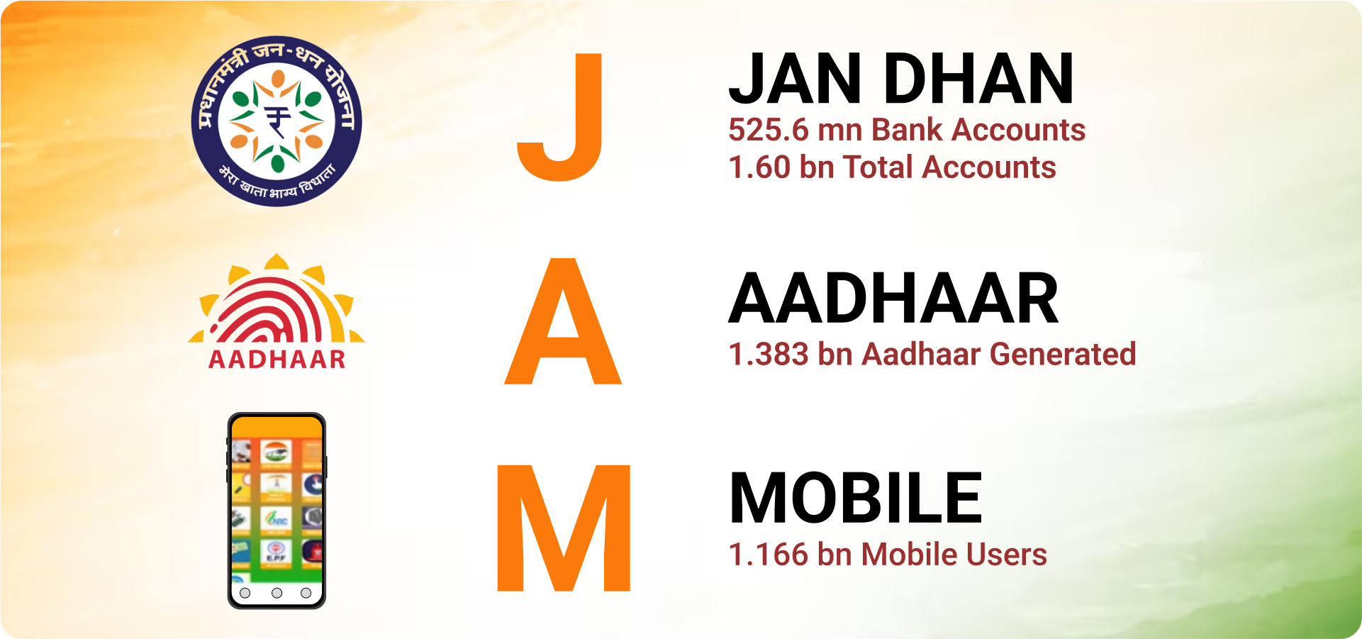
JAM trinity
539
PMJDY – 539.9 mn accounts as on 03.07.2024 (55.6% female owned, 66.5% in non urban areas)
Aadhaar – 1.4 bn as on 15.07.2024
Mobile users – >1.166 billion mobile subscribers; >1 billion smartphone users

Slide 10
Jan Dhan Yojana
Banking
Access to banking facilities
Infrastructure: Branches (1,50,000), ATMs (2,60,000), micro-ATMs (17,40,000);
Jan Dhan Darshak mobile app to locate nearby financial service touch points and identify unbanked areas
Pradhan Mantri Jan Dhan Yojana (National Financial Inclusion Drive) : 0.53 bn low value bank accounts opened [Total accounts 1.6 bn]; Zero balance account
Payments
New Products - Wide affordable Choice
NPCI as an umbrella entity for payment products
Anytime-anywhere banking: Immediate Payment Service (IMPS), Aadhaar based payment systems, Unified Payments Interface (UPI), QR Based systems
RuPay debit cards, UPI Lite, Hello! UPI, e-₹ (Digital Currency) for retail customers
Local
Leveraging existing infrastructure
~256,000 Gramin Dak Sevaks; 159,251 Post Offices
~585,000 Common Service Centres and 538,361 Fair Price Shops

Slide 11
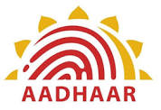
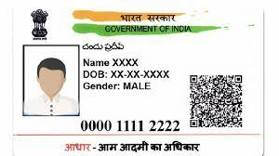
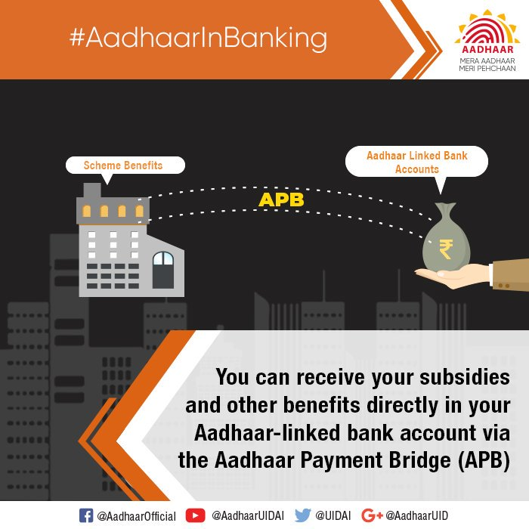
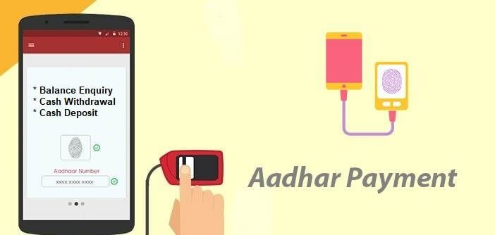
Aadhaar (1/7)
Aadhaar – 12-digit random number issued by the UIDAI
Any individual resident of India, irrespective of age and gender, may voluntarily enroll
Demographic info: Name, Date of Birth (verified) or Age (declared), Gender, Address, Mobile Number (optional) and Email ID (optional)
Biometric info: Ten Fingerprints, Two Iris Scans, and Facial Photograph
Identification
Payments
Accessing Funds
Identification, Authentication & Enrolment of beneficiary
Fund transfer to beneficiary’s bank account through Aadhaar Payments Bridge (APB)
Access to funds by beneficiary through Aadhaar-enabled Payments System (AePS) micro-ATMs

Slide 12



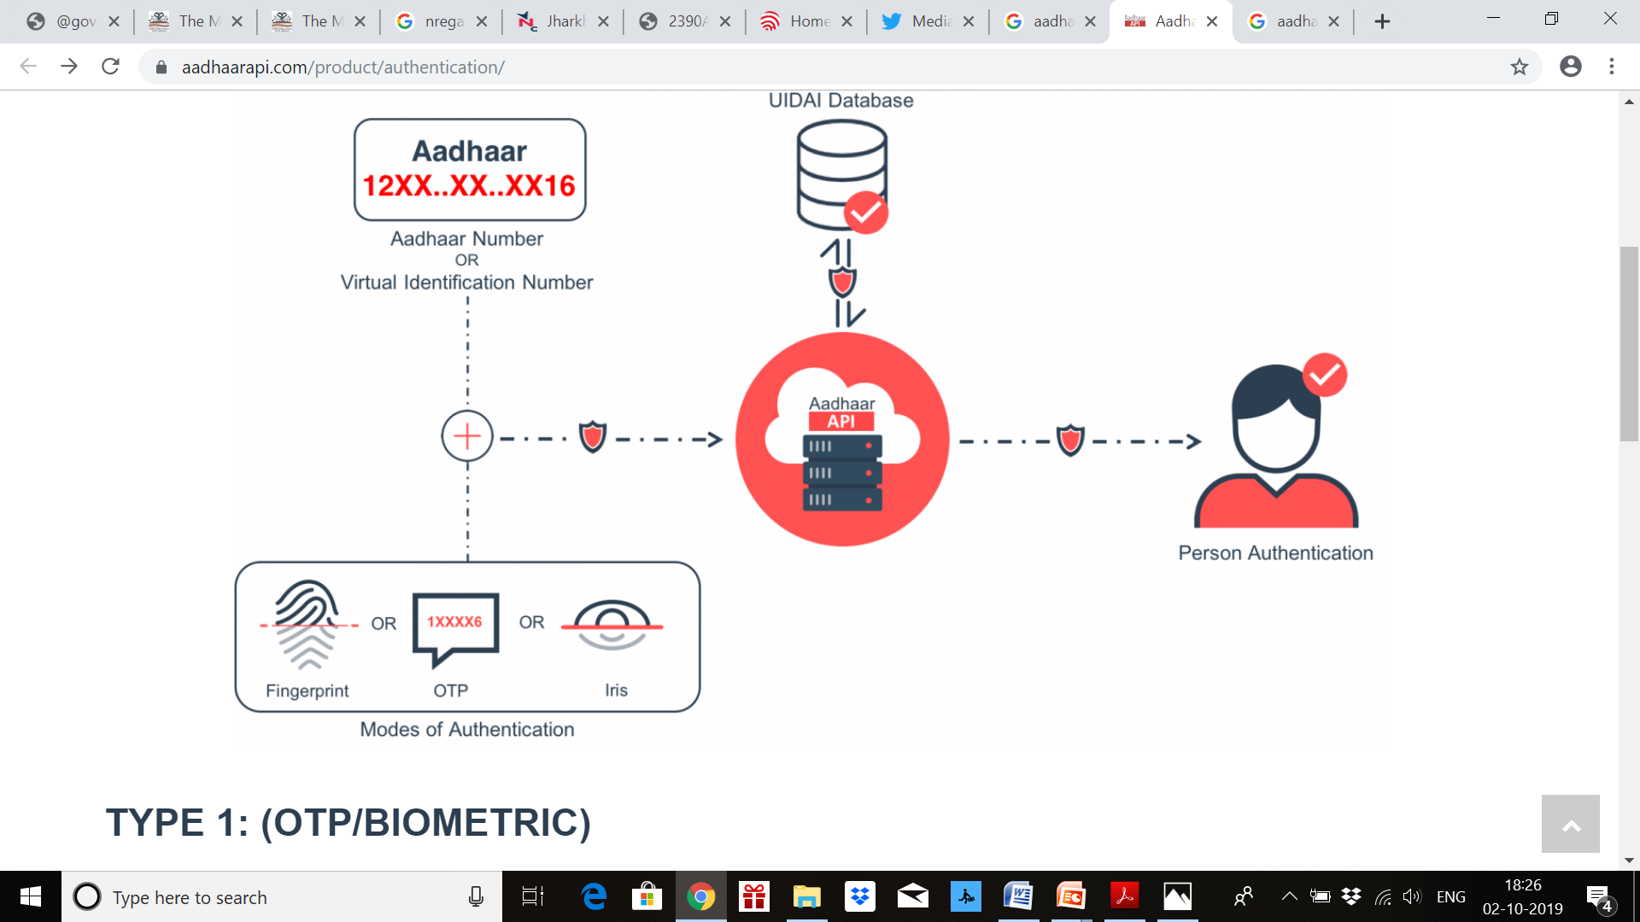


Aadhaar (2/7)
Aadhaar number (12 digit)
Or VID (16 digit)
Beneficiary databases of 320 Schemes
Aadhaar seeded records of beneficiaries
UIDAI
Central Identities Data Repository (CIDR)
Mode of authentication (at least one)
Face
Fingerprint
IRIS
OTP
Demo

Slide 13
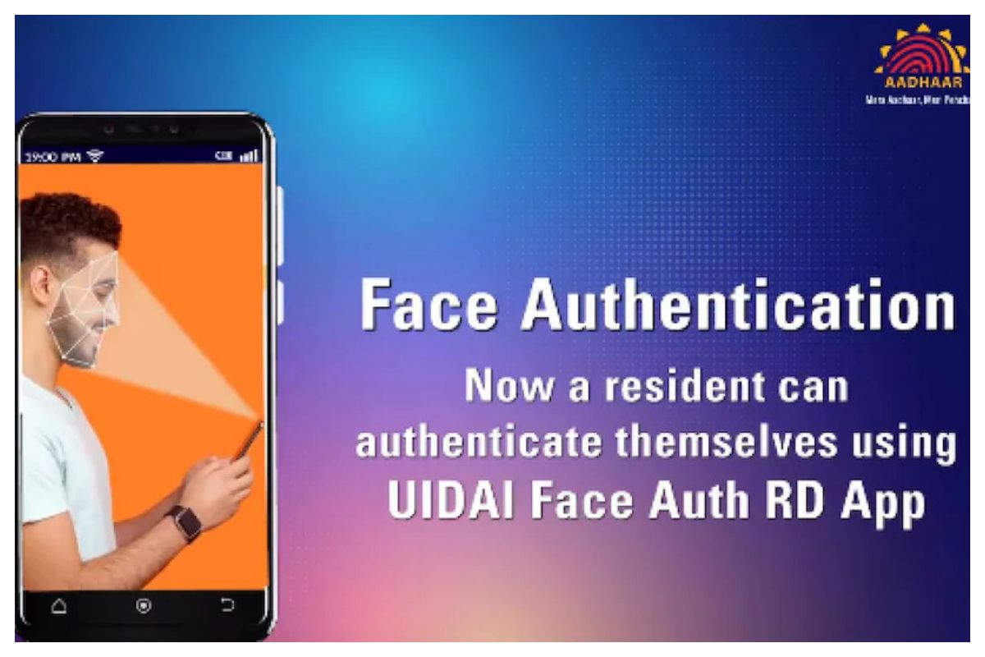
Aadhaar (3/7)
Available on Android 10.0 platforms and above
On an average, more than 8.5 cr (October) face authentications on a monthly basis
Piloted with digital life certificate
Expanded now to over 43 schemes
DigiYatra enabling document-lite travel based on face authentication at 24 airports across India

Slide 14


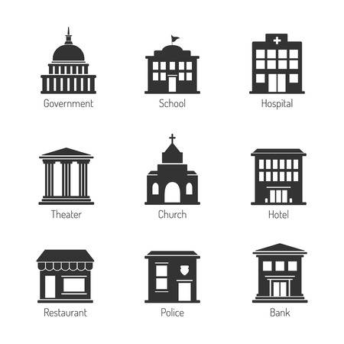

Aadhaar (4/7)
Aadhaar as a Financial Address –
Aadhaar seeding of bank accounts in Aadhaar Mapper
(a centralised repository maintained by NPCI)
854 million Aadhaar
numbers
>1,339 participating Banks
AADHAAR MAPPER
Bank
Customer to submit Consent form for getting DBT through Aadhaar
Banks to upload Aadhaar number of customer on Aadhaar mapper
BASE- Work in progress for Online Seeding

Slide 15

Aadhaar (5/7)
Payment instructions through PFMS
Using
Aadhaar & Amount
Payment instructions
Using
Aadhaar & Amount
AADHAAR PAYMENT BRIDGE
Government Department
Beneficiary Bank
AADHAAR MAPPER
Sponsor Bank
Beneficiary Bank

Slide 16
Aadhaar enabled Payment System (AePS) (6/7)
Micro ATMs (low cost ATM devices) are used by Business Correspondents to deliver basic banking services at last mile especially in areas without brick and mortar bank branch or ATM facility.
  Aadhaar-based Cash Withdrawal,
  Balance Enquiry,
  Fund Transfer,
  Mini Statement
1.74 mn inter-operable Micro-ATMs (April 2024)
Aadhaar-based eKYC (auto-population of individual details from Aadhaar database) facility for opening bank account [brought down KYC cost by more than 99.5%]
Low value transactions: ₹ 10,000 (US$120) limit for single AEPS transaction; bank-specific daily limits

Slide 17
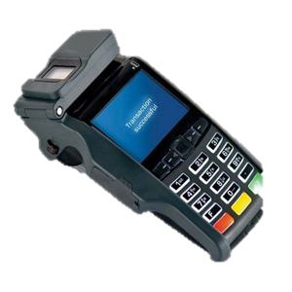

Aadhaar enabled Payment System (AePS) (7/7)
Beneficiary
Beneficiary Bank
6
Debit Customer A/c if authentication successful
1
5
UIDAI
Central Identities Data Repository (CIDR)
Withdrawal Request
& Biometric authentication
on micro-ATM
7
Authentication
Response
8
Cash
NPCI Switch
Authentication
Request
NPCI
request
4
Money Transfer request & Biometrics
3
BC’s Bank
Business Correspondent (BC) with micro-ATM
2
Process completed within few seconds!

Slide 18

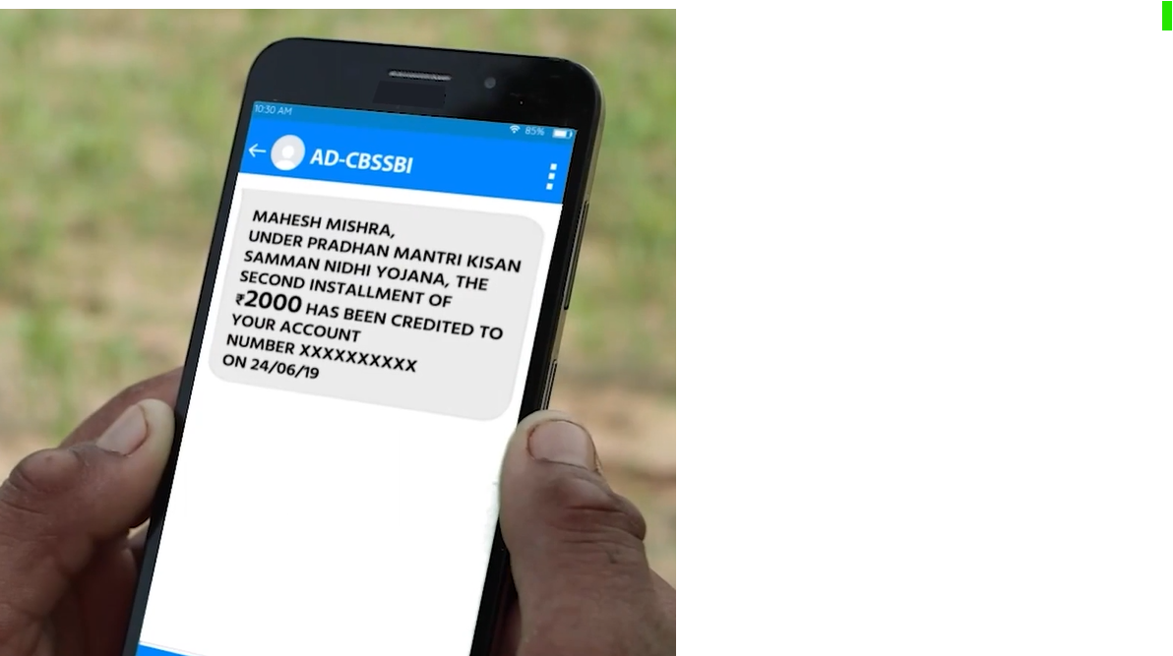
Mobile (1/2)
1.166 billion mobile telephone subscribers in India - 54% in urban areas and 45% in rural areas; ~1 billion smart phones
Second largest mobile network in the world
with most affordable tariffs (APPU<2USD)
Tele-density in India is 85.8% (April 2024)
Mobile as C2G and G2C communication tool
About 2,077 services (908 Central, 1169 State) available on UMANG (Unified Mobile Application for New Age Governance)
Self mode services on smart phones + Assisted mode for citizens without smart phones at Common Service Centres across India

Slide 19
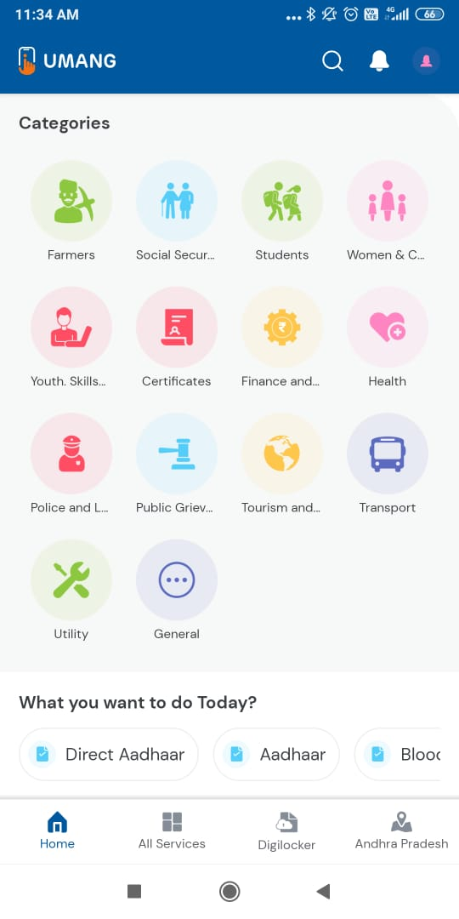
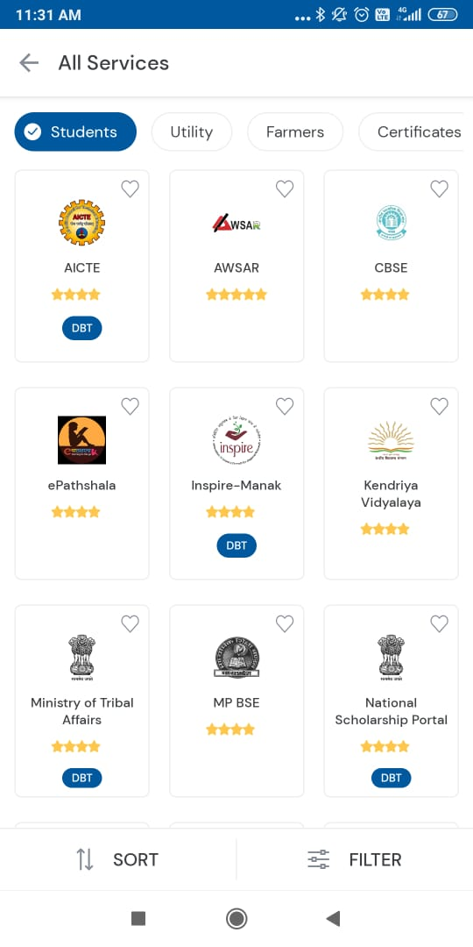
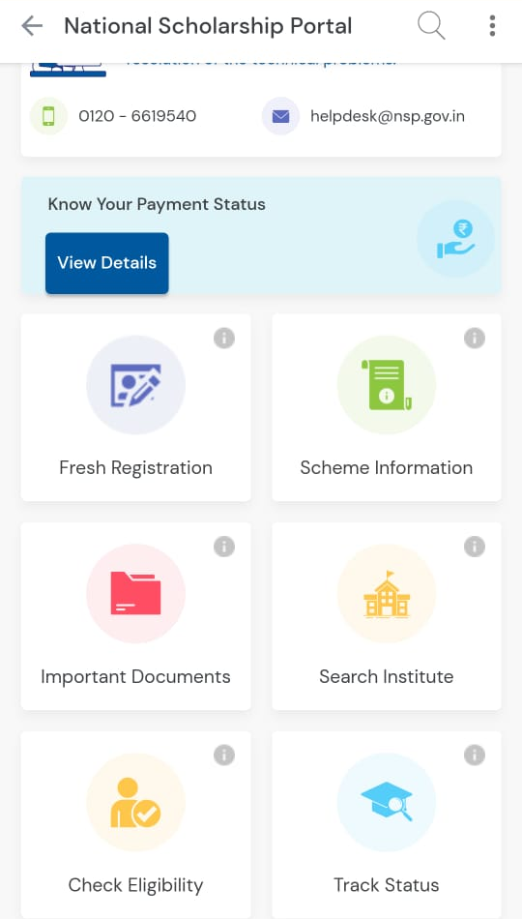
Mobile (2/2)
UMANG is well catalogued, available in 23 languages at https://web.umang.gov.in/

Slide 20


DBT casting a wide social security net
Housing support
By 13 October 2024, support provided for constructing about 8.5 mn houses in urban areas and 26.7 mn houses in rural areas
Scholarships
In 2023-24, 104 scholarship schemes benefited over 10.4 mn meritorious and needy students to the tune of Rs 137 bn
Clean cooking fuel subsidy (PAHAL)
301 mn beneficiaries getting subsidies for LPG in bank account worth Rs 40 bn
Farmer income support + Fertiliser support
Annual quasi-UBI of Rs 6000 to nearly 110 mn eligible farmers + multivariety subsidized fertilisers to 65 mn farmers
Pensions for the weaker section
Nearly 38.4 mn widows + old aged people + specially abled beneficiaries
Health support
20.3 mn persons given hospitalization support to the tune of Rs 305 bn
Wage support scheme (MGNREGA)
Wage support for low / unskilled work to 83.4 mn persons to the tune of Rs 669 bn in 2023-24
Food security (PDS)
More than 810 mn identified beneficiaries receiving multi-grain in-kind supplies worth Rs 185 bn
List of Central DBT schemes at https://dbtbharat.gov.in/central-scheme/list

Slide 21
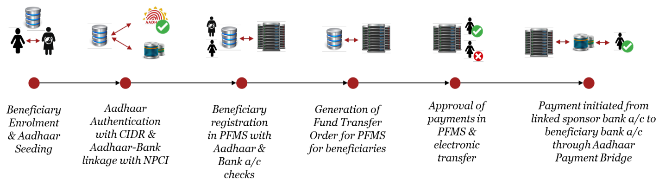
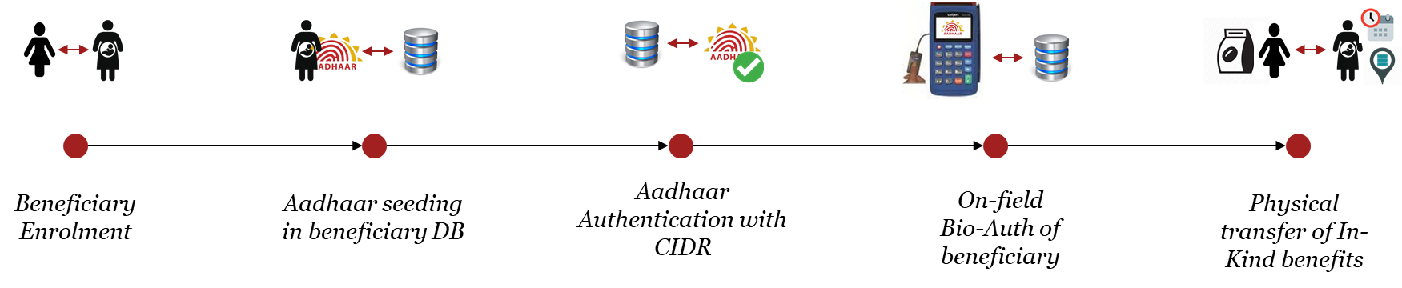
DBT Flow: Payments and Transfer
Enabling Electronic Payments
Enabling Authenticated In-kind Transfers

Slide 22
DBT implementation : Other Miscellaneous Activities
De-duplication using Aadhaar authentication and Beneficiary Authentication at time of delivery of benefit or in case of recurring schemes
  Use of Local Government Directory codes across all beneficiary databases
  DBT payments get priority in banking ecosystem. DBT transaction charges and incentives are paid to banks and NPCI as per Govt. of India instructions
  Citizen-centric Mobile App for handy information on FAQs, status updates on applications, benefit disbursement, grievance redress (CPGRAMS) etc

Slide 23
DBT Savings / Estimated gains
Aadhaar-based DBT and other governance reforms have led to removal of duplicate/ fake beneficiaries and plugging of leakages etc., resulting in better targeting of genuine beneficiaries.
Cumulative estimated savings/benefits worth ₹3.48 trillion
IMF working paper has lauded DBT for reducing leakages to the tune of 1.1% of GDP by March 2021 in three ways
  Preventing ghost and duplicate beneficiaries
  Eliminating middle men
  Increasing efficiency in in-kind benefits

Slide 24
Benefits / Gains due to DBT
Rs. 3.48 trillion Benefits / Gains due to removal of more than 100 million duplicate, fake/ non-existent beneficiaries across schemes
Cumulative Estimated Benefits / Gains
In Rs trillion
Scheme |  | Cumulative since inception Rs bn
PDS |  | 1855.73
PAHAL |  | 734.43
MGNREGS |  | 425.34
Fertilizer Subsidy |  | 187.00
Scholarships | MoMA | 19.17
 | SJ&E | 10.55
Supplementary Nutrition Program of Aanganwadi |  | 15.24
NSAP |  | 5.37
Others |  | 11.76
Available at https://dbtbharat.gov.in/static-page-content/spagecont?id=18

Slide 25

Global acclaim for Aadhaar-based DBT
David Malpass (erstwhile President, World Bank)
“…through digital cash transfer, India was able to provide food and cash support to 85 per cent of the households in rural areas and 69 per cent of the households in the urban area, which is remarkable…”
Paulo Mauro (Dy Dir, Fiscal Affairs, IMF)
“…it is a logistical marvel how these programmes that seek to help people who are at low-income levels reach literally hundreds of millions of people…”
“Aadhaar is the most important technological system in the world right now. It has laid the foundation of a platform to enable people to avail government benefits, including direct benefit transfer” – Paul Romer, Nobel Laureate and former chief economist of The World Bank

Slide 26
Way Forward

Slide 27
Online eligibility verification mechanism (DBT 2.0)
Ministries/Departments to clearly mention eligibility criteria for their respective DBT schemes; illustrative list of certificates are as follows
Replacement of physical documents with electronic records can save resources, enhance productivity and efficiency of DBT ecosystem
Issues certificate in electronic machine readable format and seed with Aadhaar.
Eligibility documentation and verification to be done electronically through trusted Database intermediary with Aadhaar as the Primary Key.
Birth Certificate | (f) Death Certificate
(b) Income Certificate | (g) Disability certificate
(c) Caste Certificate (including SC/ST/OBC etc.) | (h) Senior Citizen Certificate
(d) Residence / Domicile Certificate | (i) Land Records
(e) Educational Certificates | (j) Marriage Certificate

Slide 28
Social registry (DBT 3.0)
Suo-Moto delivery of Benefits
A National Family Register is being contemplated to provide a single source of truth for family as a unit.
It will provide a unique family ID.
Some states have taken initiatives in this regard – Kutumba (Karnataka), Parivaar Pehchaan Patra (Haryana), Samagra (Madhya Pradesh), Jan Aadhaar (Rajasthan), etc.
Aggregated view of family across schemes:
  Enable delivery of all services/schemes to a family as a unit
  Helps in identification of inclusion and exclusion errors

Slide 29
Thank You

Slide 30
Relevance for South Africa – likeliness with India context
Both India and South Africa have established democratic systems of governance. Indian DPIs are based on democratizing access to public services.
Similarity in federal setup of government institutions. DBT in India is run on the basis of cooperative federalism.
Both nations are known for their cultural diversity, with multiple languages, religions, and ethnic groups coexisting. DBT experience in India caters to a wide range of diversities. (e.g. multilingual apps)
Both India and South Africa are considered emerging economies with significant growth potential. They have diverse economies with strong agricultural, industrial, and service sectors. India DPIs help to provide economic boost to private entrepreneurship as well as social security nets.
South Africa can gain significantly from India's experience with Direct Benefit Transfer (DBT) by adopting similar strategies to enhance the efficiency and transparency of social welfare programs.

Slide 31
Digital Public Infrastructure (DPI)
Under India’s Presidency, G20 Digital Economy Ministers reached a groundbreaking consensus on how to effectively shape digital public infrastructure (DPI) of the future, as an accelerator of the Sustainable Development Goals (SDGs).
A description of DPI has been collectively adopted by a group of countries, as
  “a set of shared digital systems; that should be
  secure and interoperable;
  that can be built on open standards, and
  promote access to services for all,
  with governance and community as core components of DPI”.
Link: https://static.pib.gov.in/WriteReadData/specificdocs/documents/2023/aug/doc2023824243701.pdf

Slide 32


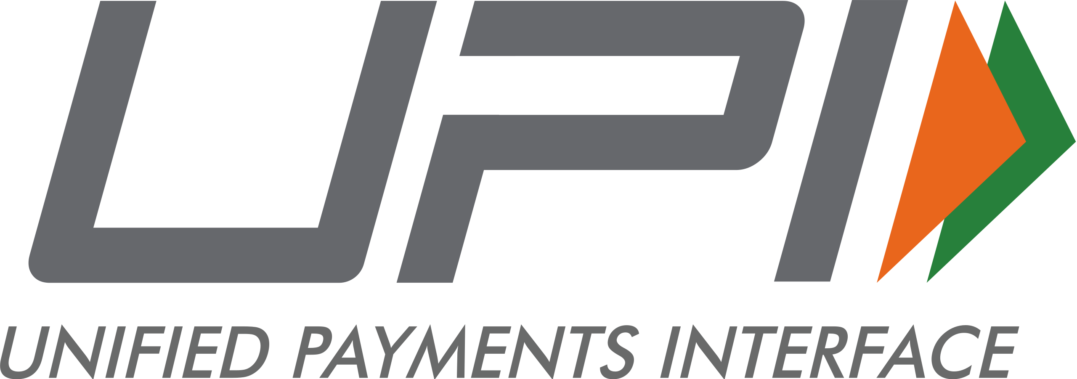
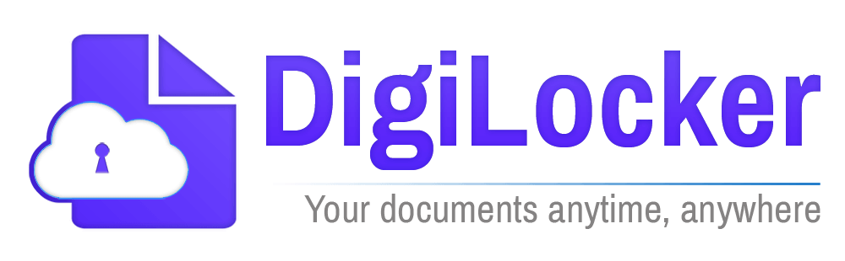
India’s DPI – India Stack – home grown, world class!
Identity
Payments
Data

Slide 33
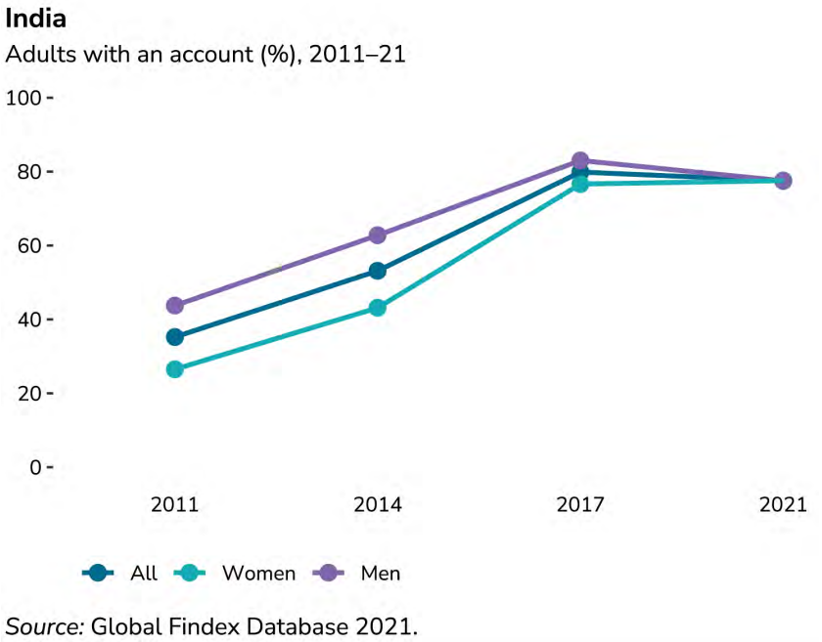
Jan Dhan Yojana (1/2)
From “targeted delivery” to “last-mile access”
Effective, efficient and timely delivery of Government subsidy and benefits require easily accessible and affordable financial products and infrastructure
'Pradhan Mantri Jan-Dhan Yojana’ as a National Mission on Financial Inclusion in 2014 – an integrated approach for comprehensive financial inclusion for every households in the country
Universal access to banking facilities with at least one basic banking account for every household, financial literacy, access to credit, insurance and pension facility
Expanded coverage from “every household to every adult” – Global Findex confirms the closure of gender, income gaps in account ownership

Slide 34
Use of DBT Scheme codes
All DBT schemes on-boarded on DBT Bharat Portal are provided with unique 5 digit, alphanumeric DBT scheme codes. Nomenclature denotes implementation responsibility in the scheme.
Required to be used in payment files with beneficiary payments which enable the banking ecosystem to identify and prioritise DBT transactions
Helps in minimizing failure / return of payments by enforcing various Government directives on DBT Payments (Eg. allowing of DBT payment in a dormant bank account of beneficiary)
Data analytics (e.g. Calculation of DBT transactions, volumes, commission to banks and BCs) is possible
Mandatory mapping of DBT Codes in Public Financial Management System (PFMS)

Slide 35
Future thinking on DBT
DBT 1.0
DBT 2.0
DBT 3.0
Assigning and authenticating identity; direct transfer to beneficiary bank accounts
Improving Eligibility Verification
Social Registry (Suo moto determination of Eligibility)
On line Enrolment | Processing of Application | Disbursal of Benefits | Follow-up / Feedback
Enrolment drive in low saturation States / age-groups Alternate and viable means of identification Provision for online and mobile-based application Reducing Aadhaar authentication failure (promoting IRIS devices, OTP, better connectivity) Offline verification using QR code in remote areas | Broad Consent Stringent due diligence for non-Aadhaar applications Real-time verification of eligibility using Aadhaar-seeded databases (Eg. PAN, Board / University, Ration card, Caste / Income / disability Certificates, SECC records, land records, Govt. employee database, Motor Vehicle, unorganized labour, MGNREGA) DigiLocker / API Setu as single source of truth | Mandatory disbursal in Aadhaar-linked bank account (Aadhaar as a financial address) Exploring alternate digital means (cash / e-voucher etc) for identified in-kind schemes | Physical Checks Suo-moto Disclosure Social Audit Grievance Redressal Online and mobile-based access to information and transactional services

Slide 36
Digital payments through UPI
Immediate money transfer through mobile device round the clock 24*7 and 365 days from wallet / bank account
80% of digital payments in India through UPI; India accounts for 48% of all digital payments in the world
Smart phone + feature phone
International collaboration – Singapore, France, Mauritius, Sri Lanka, Bhutan, Nepal, UAE
Credit line being envisioned

