Slide 1
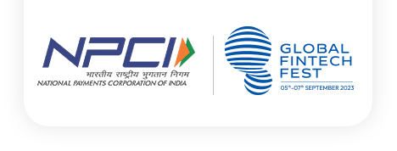
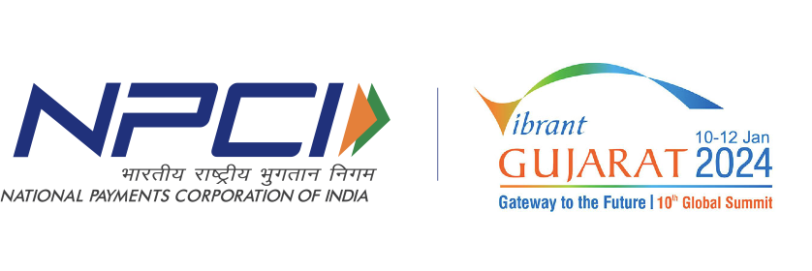

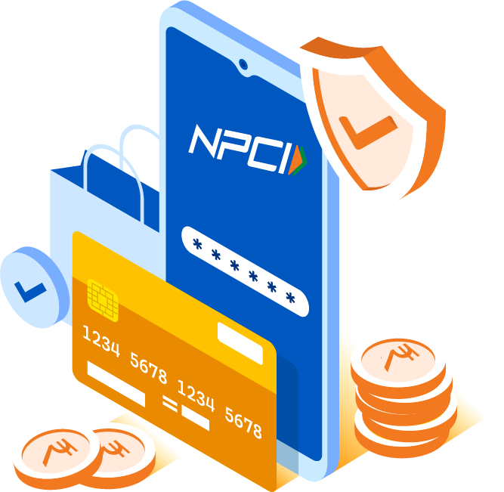
NPCI Presentation
Dec2024

Slide 2
Building Digital Platforms

Slide 3



India Story: India leading from the front in the Digital space with India Stack
80%
Population with the access to banking services
1st
Country with large liberalized internet
(Affordable data, 1.2 Bn mobile phone users with 70% smartphone)
1st
Largest digital ID issuance under Aadhaar scheme with 1.3 billion
5th
5th Largest economy in the world
(poised to become 3rd largest with GDP of $5 Tn)
3rd
  3rd Largest cloud enabled market with $5.6 Bn, powering Fintech and new age Ecosystem
Source : Statista , IMF
3

Slide 4



India’s Approach towards building Digital Platforms
01
02
03
Public Good
Deep Tech
Ecosystem Builder
Large citizen scale public platforms
(Aadhaar, NPCI, COWIN)
AI, advanced open source, Cloud Ready
Innovation led Government and Regulatory Policies
Not for profit Institution
10 Billion a Day Architecture
Support entrepreneurial ecosystems
Protect from Private Interest and
misuse of data
Low cost, asset-lite, high-speed payments
Ecosystem led local Innovation
4

Slide 5









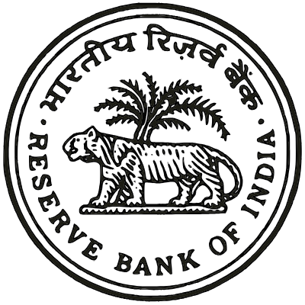




Ecosystem Expectations from Digital Public Infrastructure (Payment)
The delivery conundrum
01
02
03
04
05
06
Innovate
Scalable, Available, Reliable
Help them be
profitable / viable
Design and Build
Together
Regulatory compliance
Partake in
Governance
Expectations
Fintechs / Startups
Banks
Banking Association
Regulator
Government
ECOSYSTEM
5

Slide 6
Creating value through UPI

Slide 7
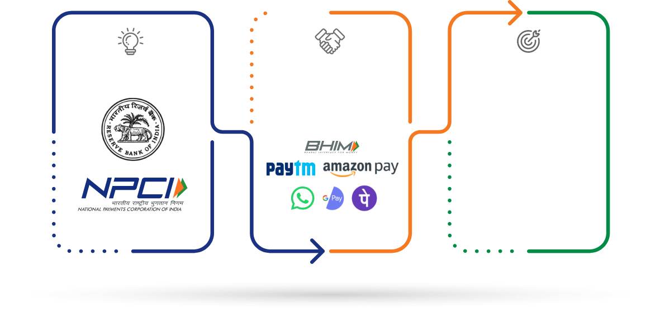
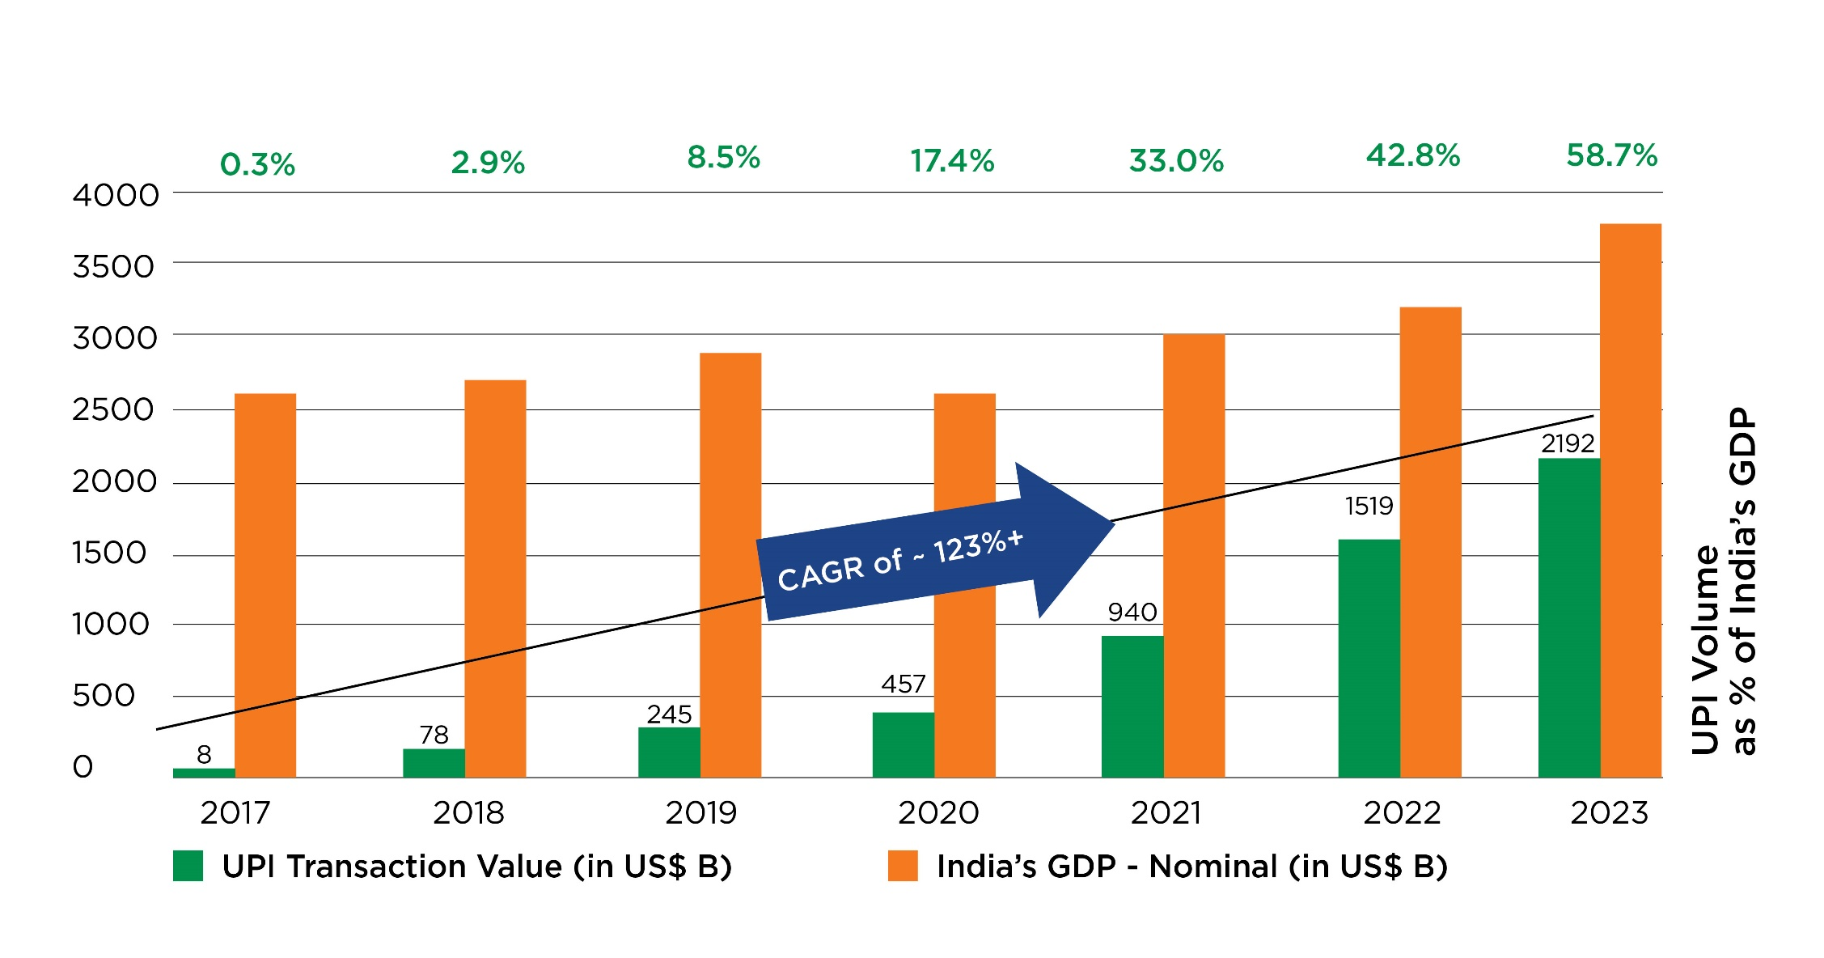



With UPI, India is the Global Leader in Digital Payments
UPI processed 15.48 Billion financial transactions and USD 250 Billion transaction value in December 2024
UPI’s Eco-system
UPI’s Performance in India
Facilitators
Participants
Banks – 600+
APP Providers – 100+
Users:
450+ Million
Merchants:
60+ Million
10 Billion a Day architecture
Total TPS capacity – 50,000
Response time – 100 milliseconds
75% share in digital payments in India and growing
49% of instant payments in world are processed on UPI
US$ 2.2 Trillion worth commerce in 2023
7

Slide 8


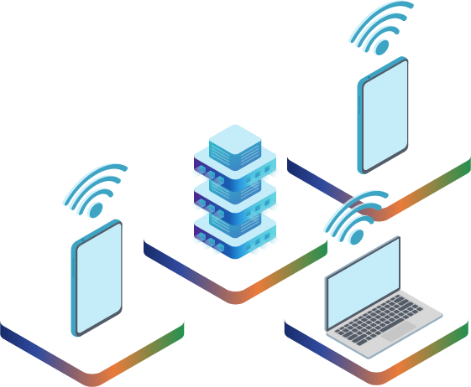
Impact of UPI
01
Attracting investments and FDI
Acceleration of e-commerce, New platform business models
Formalization, transparency, & increased tax pool
Resilience during Covid
Financial inclusion
02
03
04
05
8

Slide 9
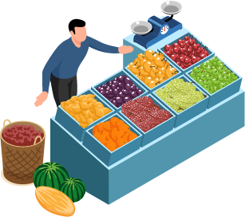

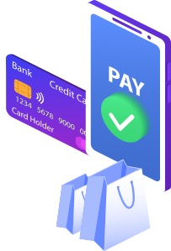
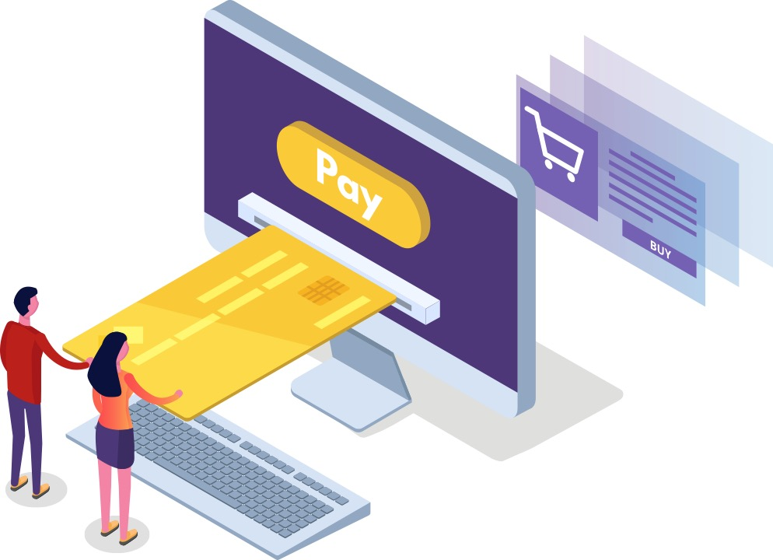
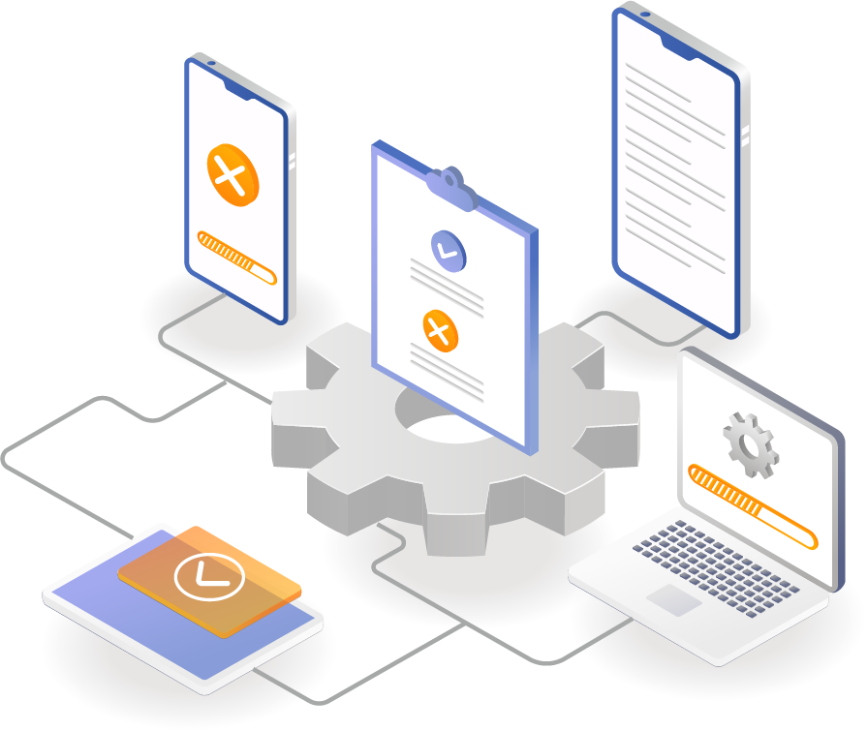
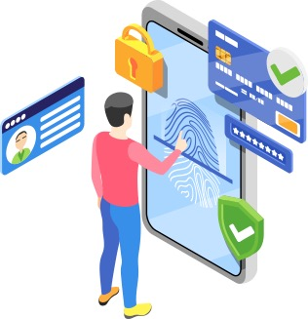

Value created by UPI across multiple use-cases
Merchant Payments
Personal Payments
UPI on Delivery
eCommerce
AutoPay - Recurring Payments
On-boarding through Aadhaar
Voice based payments
Capital Market – IPO / secondary market
9

Slide 10
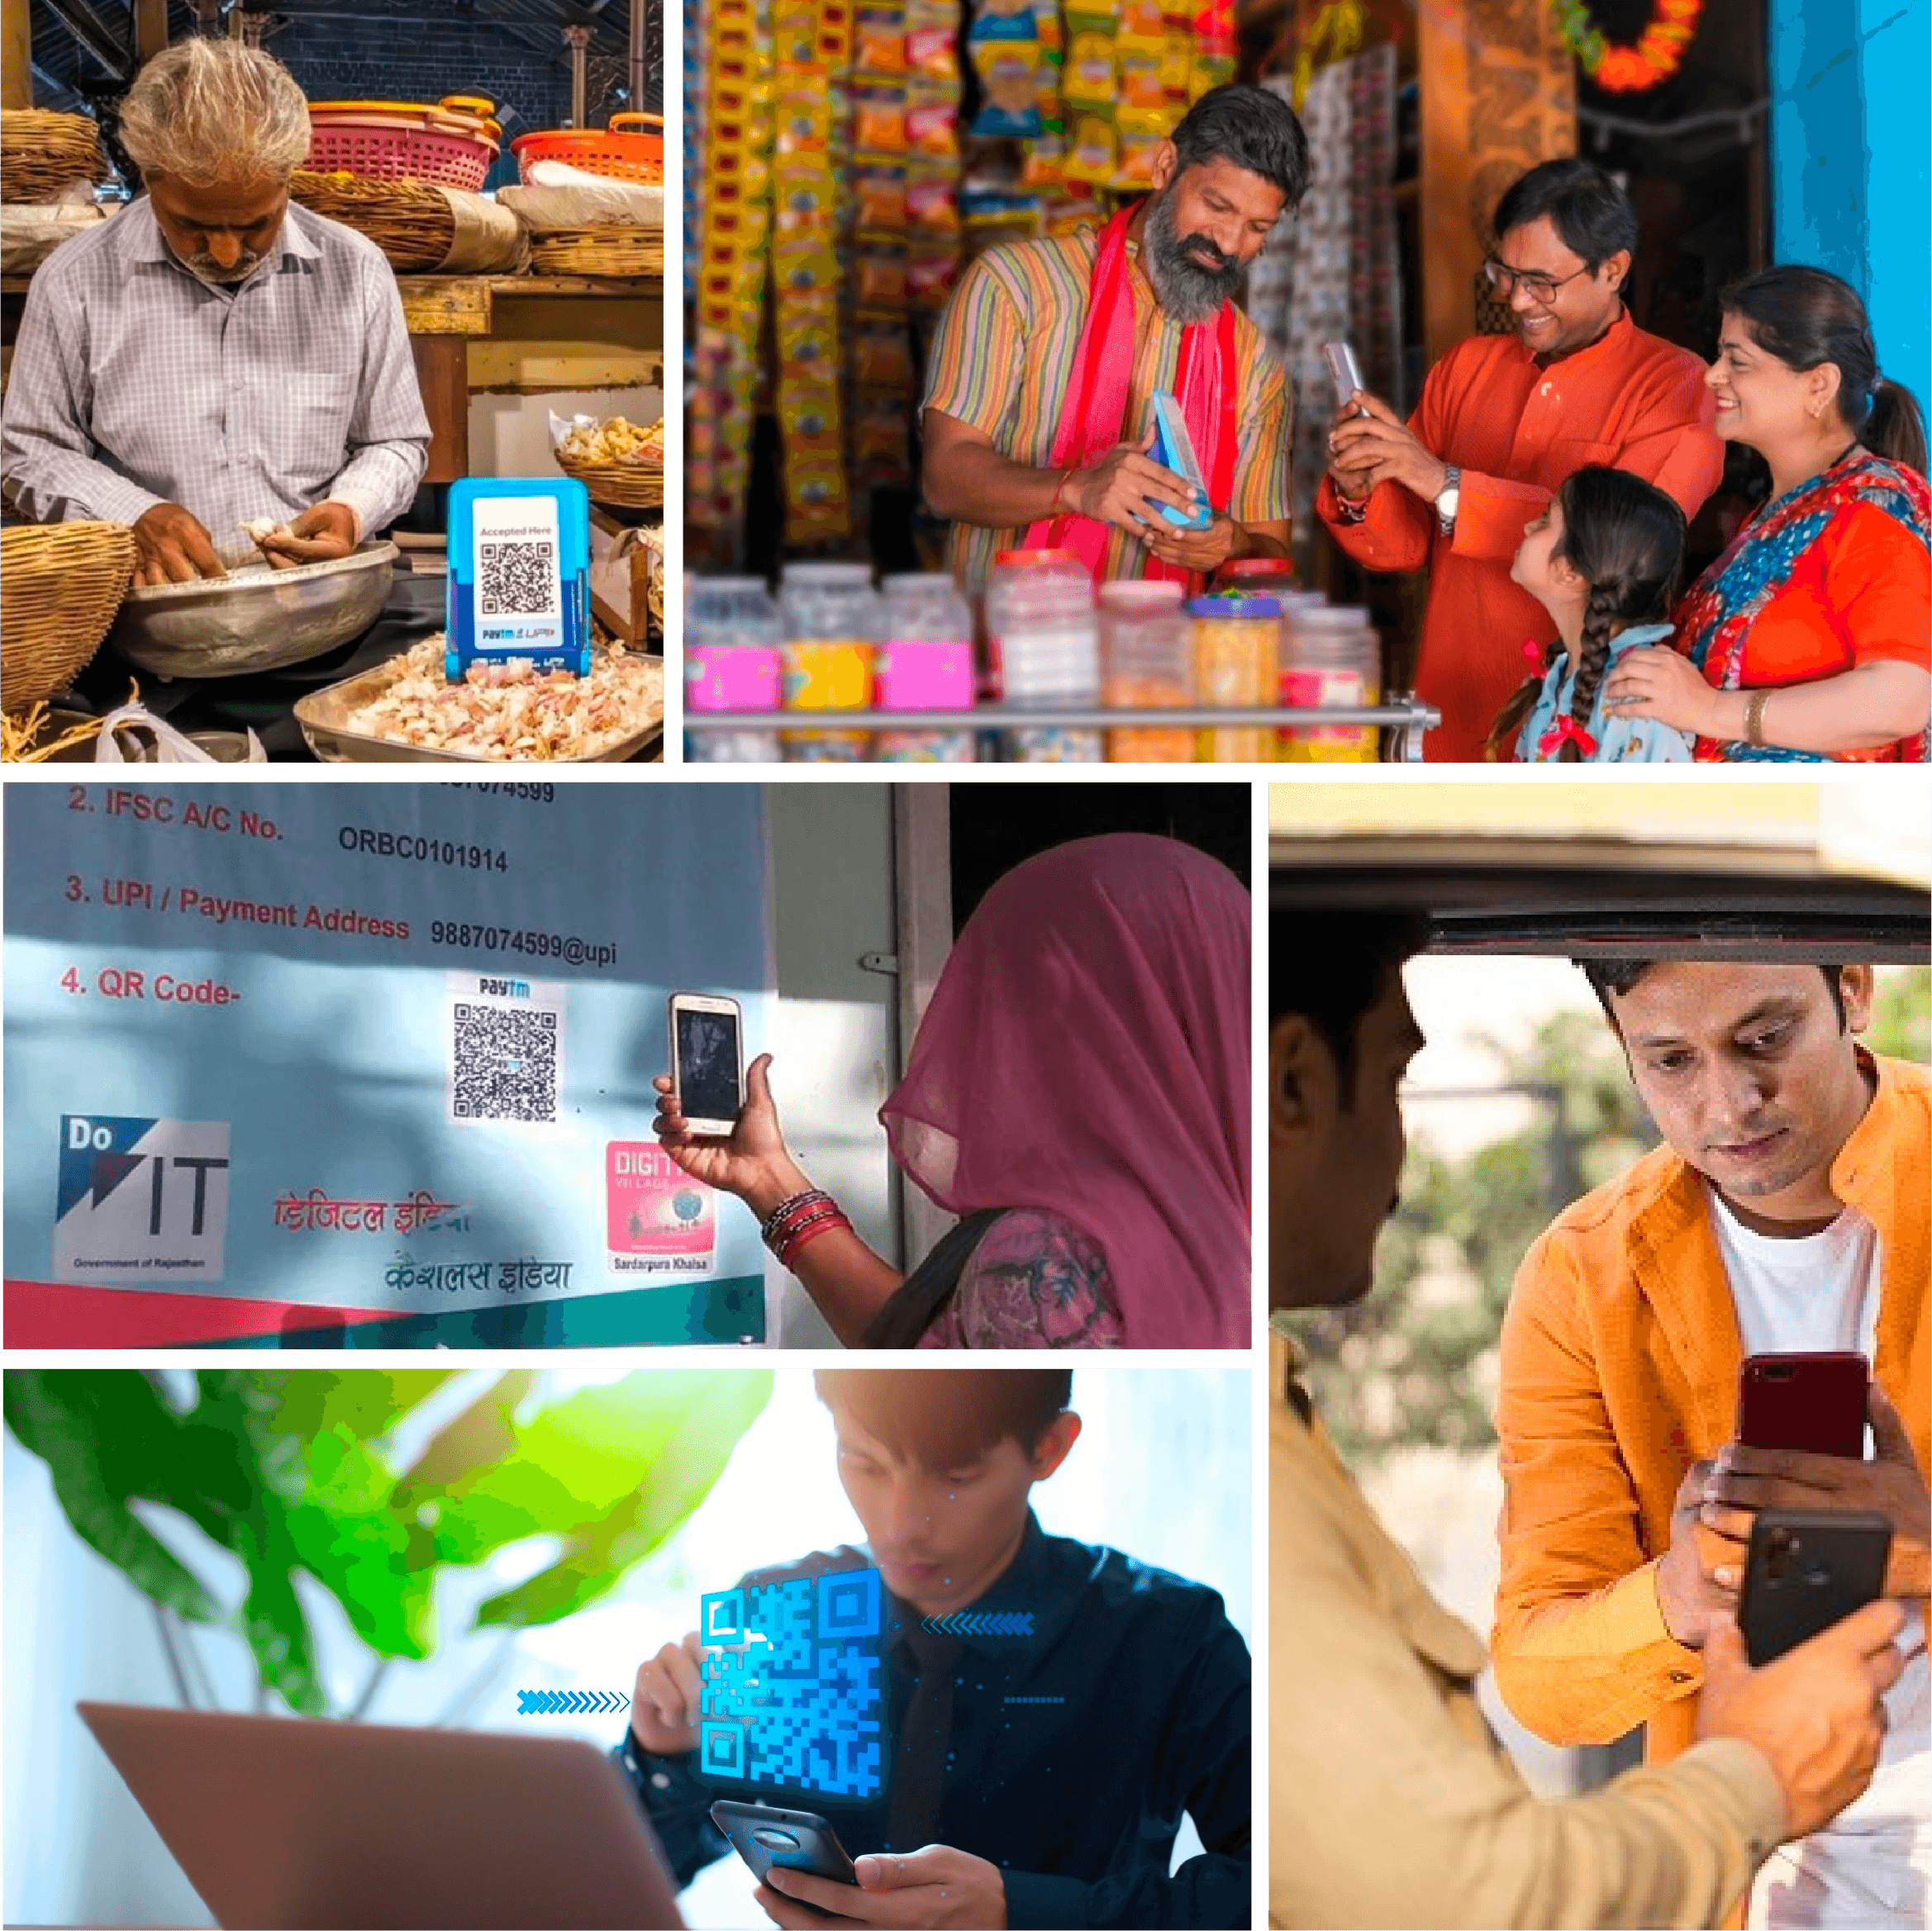

Value created by UPI like deployment runs across multiple use-cases
UPI for Citizens
01
Affordable
02
Interoperable
03
Convenience
04
Secure, Data Protection
10

Slide 11
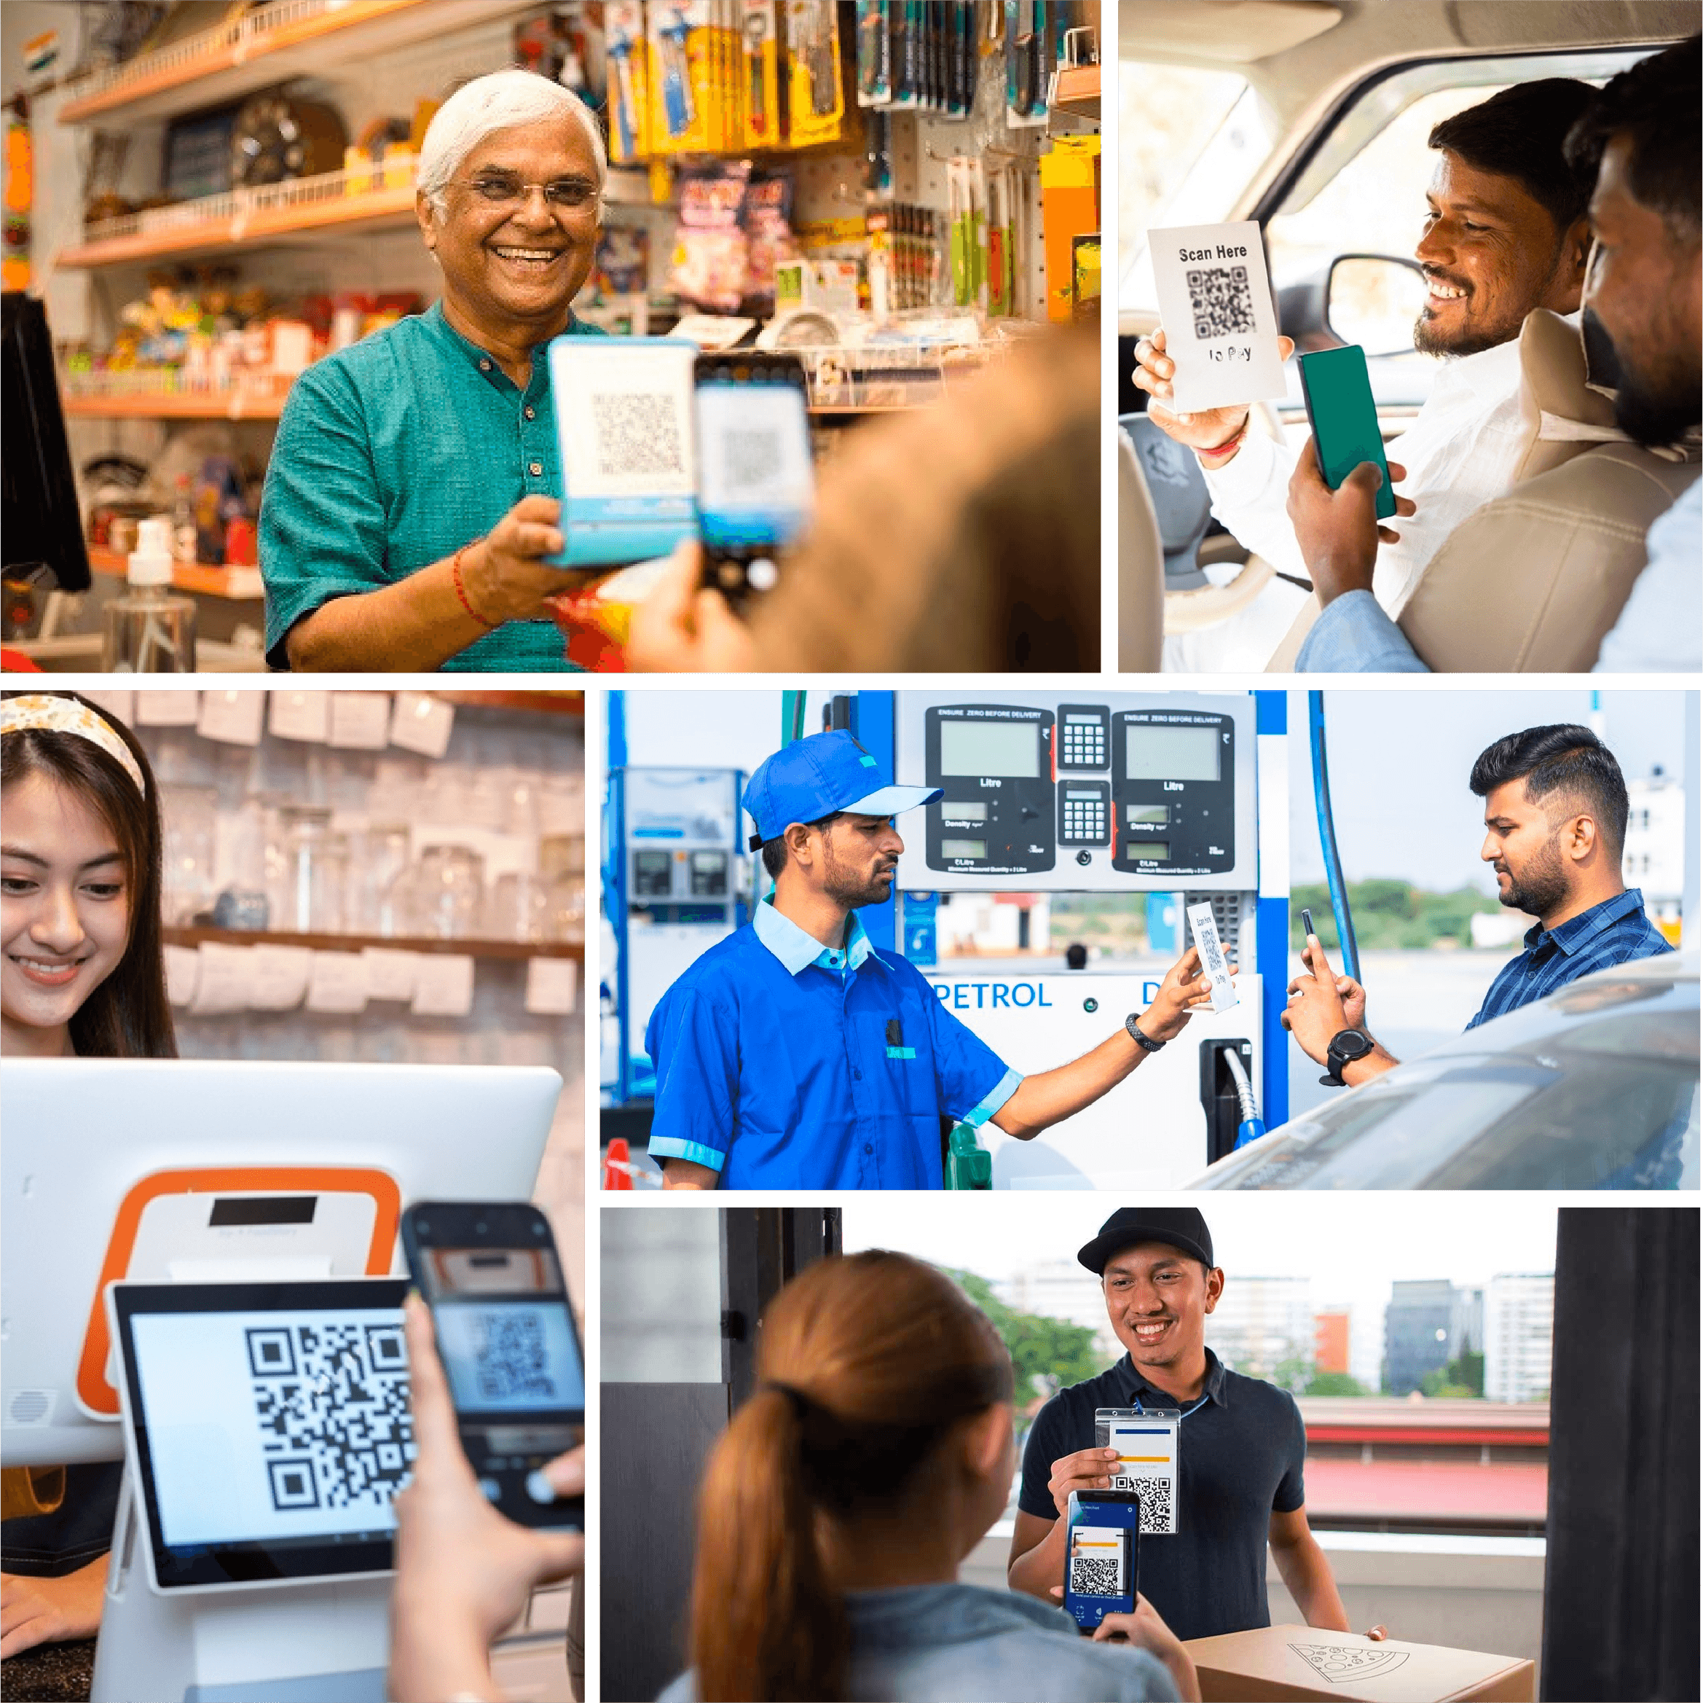
Value created by UPI like deployment runs across multiple use-cases
UPI for MSMEs and Street Vendors
01
Low-cost Infrastructure (QR Code)
02
Ease of use, Real-time Payment
03
Contactless, Less cash handling
04
Access to Credit (leverage data)
11

Slide 12
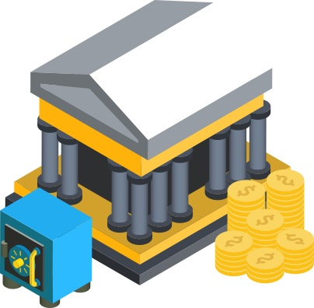
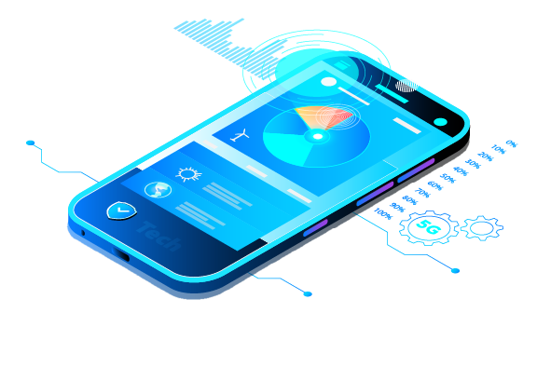
UPI’s open architecture has democratized payments, leading to fair competition
UPI for Banks & Fintech
Banks
Fintechs
Low-cost alternative to cash transactions
Lite / LiteX: Easing the load on banks
Building robust underwriting models
Fosters innovation and development of products
Promotes partnerships for customer centric solutions
Co-create with ecosystem
12

Slide 13
Value created by UPI like deployment runs across multiple use-cases
UPI has
450+
million
users
60+
500+
million financial transactions per day​
million merchants
01
02
03
04
05
06
Conversional
Payments​
E-Rupi
Contactless
Offline Payments​
UPI Credit
UPI <> RuPay ​
Credit Card​
QR
Hello UPI! Voice based payments ​
UPI 123Pay- voice/missed call based payments​
Multiple use cases (Scholarship, subsidies etc.)​
Only mobile phone and e-voucher required​
On-Device Wallet​
Reduce technical declines & load of Core Banking System​
Offline payments (No internet)​
Instant credit on demand to boost Credit​
Ease of use of Credit lines​
Access to 6+ crore UPI
merchants for Credit acceptance​
Step-up Credit​
In-built EMI in ​
UPI Apps ​
Recurring mandate​
EMI through QR​
13

Slide 14
Globalization of UPI & RuPay

Slide 15


Globalization
Domestic Instant Payment System
UPI like platform, leveraging UPI Stack
Domestic Card Scheme
Domestic card scheme using RuPay stack
Infrastructure Build
Merchant Payments
Acceptance of UPI powered Apps and drive through-put
Cross-border Remittances
Integrate with other UPI like platforms and drive through-put
Interoperability Build
15

Slide 16



























Our Global Partnerships and Progress
Trinidad and Tobago
Peru
France
Namibia
UAE
Mauritius
Nepal
Bhutan
Singapore
Sri Lanka
Maldives
UPI Acceptance
Inward & Outward Remittance
Domestic Card Scheme Infra Build
RuPay Card
Acceptance
UPI
Acceptance
UPI
Acceptance
RuPay Card Acceptance
UPI Acceptance
Instant Payment Scheme Infra Build
Instant Payment Scheme Infra Build
UPI Acceptance
Instant Payment Scheme Infra Build
RuPay Card
Acceptance
RuPay Card
Acceptance
Rupay card
issuance
UPI
Acceptance
UPI
Acceptance
RuPay Card
Acceptance
UPI Acceptance
16
Notes:
To improve on this slide

Slide 17
THANK YOU

